Slide 1
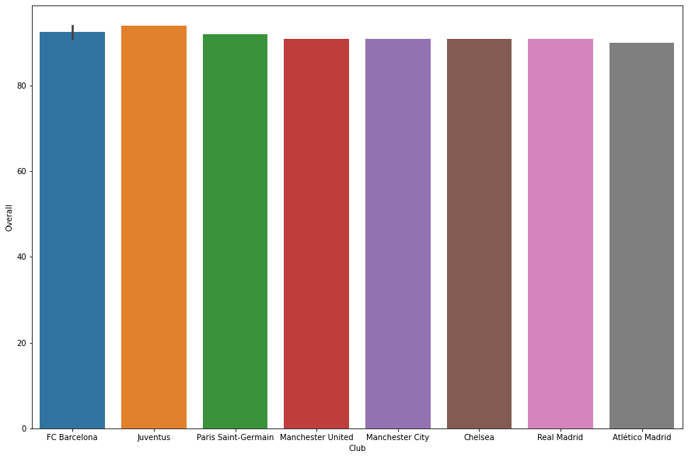
Top 8 clubs having highest rated players
From the image given we can infer that :
FC Barcelona and Juventus are the clubs which have the top overall rated player
Apart from these we have Paris Saint, Manchester United, Manchester City, Chelsea, Real Madrid and Atlético Madrid share the nest consecutive ranks.

Slide 2
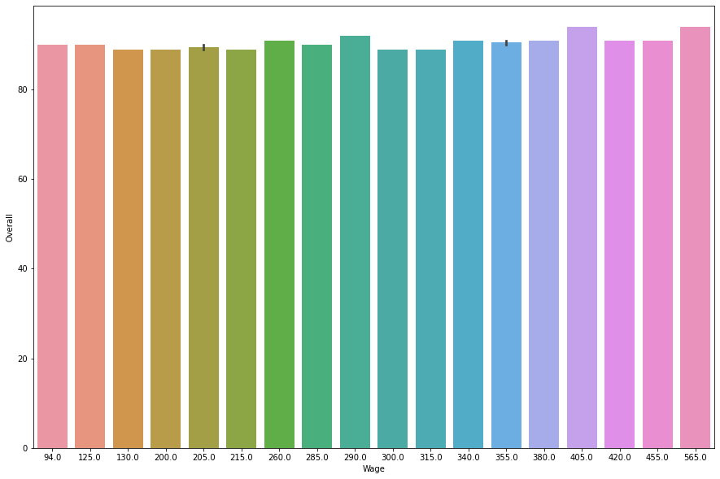
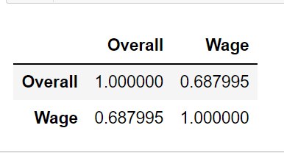
Correlation of wages with respect to overall rating
From the image given we can infer that :
Wages and Overall rating has a high positive correlation
Higher the Overall higher is the wage

Slide 3
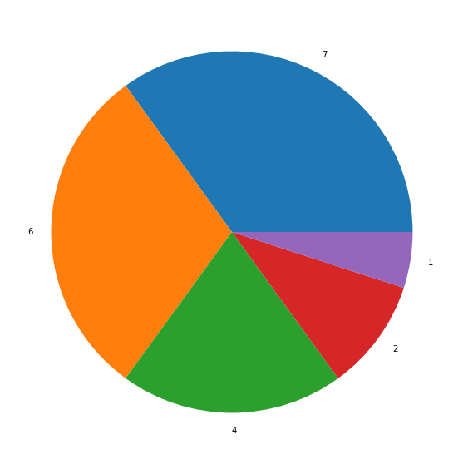
TOP 20 players whose contracts expiry year has been calculated
From the image given we can infer that :
Currently 6 top players are currently in a club, who is actively playing for a club
Almost 14 of the top players have been already out of their respective clubs due to closure of contracts
2020
2021
2019
2023
2022

Slide 4
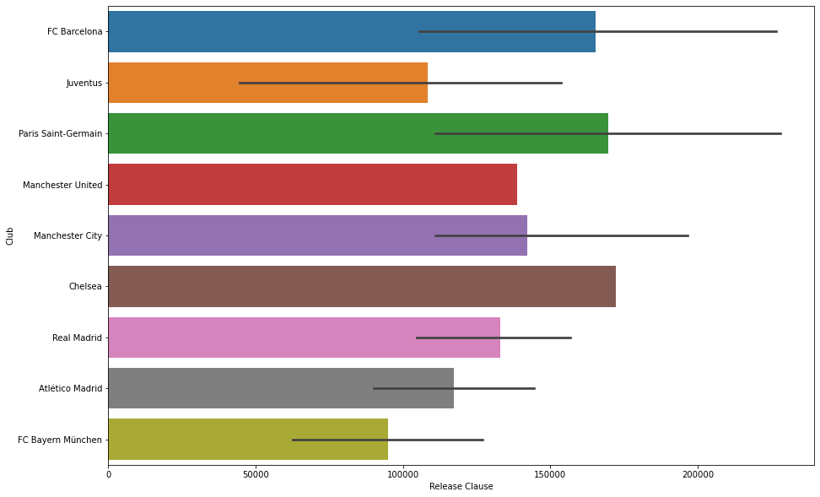
Understanding the release clause with respect to clubs for the top 20 players
From the image given we can infer that :
We can infer that FC Barcelona and Paris Saint-Germain have almost the same Release Value
FC Bayern Munchen has the least Release Clause .

